Slide 1
Warranty Exit Red Program
2008 Process Flow
Davide Monteforte / Riccardo Fenili
Business Operation and HW Maintenance SW IOT leaders

Slide 2
Warranty Exit RED 2008 Process (i, p and SSD products)
60 days after HW sold
Maintenance attached?
1
Yes
Box covered
Attach rate result
No
90 days before WE
Selected BP?
Top 18 BP/Distr
2
Others
Yes
No
Time Table
M&TS IOT Ops extract the list
M&TS IOT Ops
60 days after Hw sold
extract the list
Attach Rate measurement
90 days before warranty
2A
With or Without End User
End-User Known ?
Expiration
No
2B
(*)
Yes
Uncovered machine list
sent to BP - Telesales
List provided to BPs through IMTs BPO Leaders
List provided to IMT BPO Leader
List provided to Telesales
30 days before warranty
expiration
Uncovered machine list
Maintenance attached?
Maintenance attached ?
sent to Telesales
30 days before WE
3
Yes
Box covered
3
Yes
Box covered
30 days After warranty
No
expiration
No
Uncovered machine list
List provided to Telesales
List provided to Telesales
produced for result analysis
Warranty expired
Maintenance attached?
Box covered
Yes
4
No
Provide feedback to IMT WE Focal point
(*) Process deviation, locally decided, could be accepted after communicated to IOT

Slide 3
Warranty Exit process flow for i, p and SSD products
Step 1. (60 days after product placement)
  Covered machines measured as Attach Rate results from Pan IOT B.O. team
Step 2. (90 days before warranty expiration time)
  Uncovered machines lists are produced (Pan IOT) for :
      Top BPs / Distributors (see specific list in the process flow chart, pag. 2)
      Other ( BPs not included in the selected list)
      Machines in these lists will be included in the “sell install file” as well
Step 2A. (top BPs/ Distr.)
  List sent to BPO IMT leaders for analysis and specific actions
Step 2B. (other)
  If “End User” known, list will be sent to Tele Sales through IOT B.O. for customer calls
  When “End User not known” , list will be sent to BPO IMT leaders for data collection and actions
Step 3. (30 days before warranty expiration date)
  New list will be produced (PAN IOT) and sent to Telesales for Customer calls
  Telesales will disengage when customer will communicate he is already dealing with a specific BP
  Telesales, for all the Customers they disengaged, will send an email to: BPs mentioned by customer BPO IMTs interface
Step 4. (30 day after warranty expired)
  New list will be produced and sent to IMT warranty Exit Focal Point for additional analysis and results evaluation

Slide 4
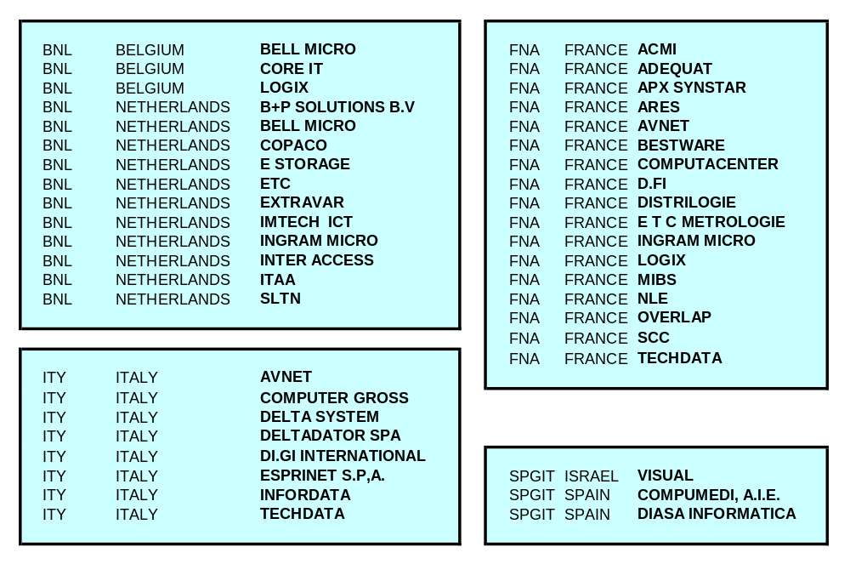
Selected Business Partners list

Slide 5
Measurement - closest to the Business needs - July 2008
Warranty Exit
Potential measurement
N^ of prd out
of warranty
100
100
100
100
100
100
100
100
1st
measurement
May
June
July
August
Sept.
Oct.
Nov.
Dec
2008
Warranty Exit
Potential measurement
N^ of prd out
of warranty
100
100
100
100
100
100
100
100
2nd
measurement
May
June
July
August
Sept.
Oct.
Nov.
Dec
2008
12-88
2-98
3-97
1-99
100
100
100
100
Warranty Exit
Sign Rate
Warranty Exit
Potential measurement
N^ of prd out
of warranty
100
100
100
100
100
100
100
100
3rd
measurement
May
June
July
August
Sept.
Oct.
Nov.
Dec
2008
36-64
16-84
9-91
6-94
4-96
100
2-98
100
Warranty Exit
Sign Rate

